Slide 1

Building Multi-Tenant Applications with ASP.NET Core & the ABP Framework
Halil İbrahim Kalkan

Slide 2

Agenda
SaaS & Multi-Tenancy
About the ABP Framework
Demo: Multi-Tenancy in Action
Multi-Tenant Development with the ABP Framework
QA

Slide 3
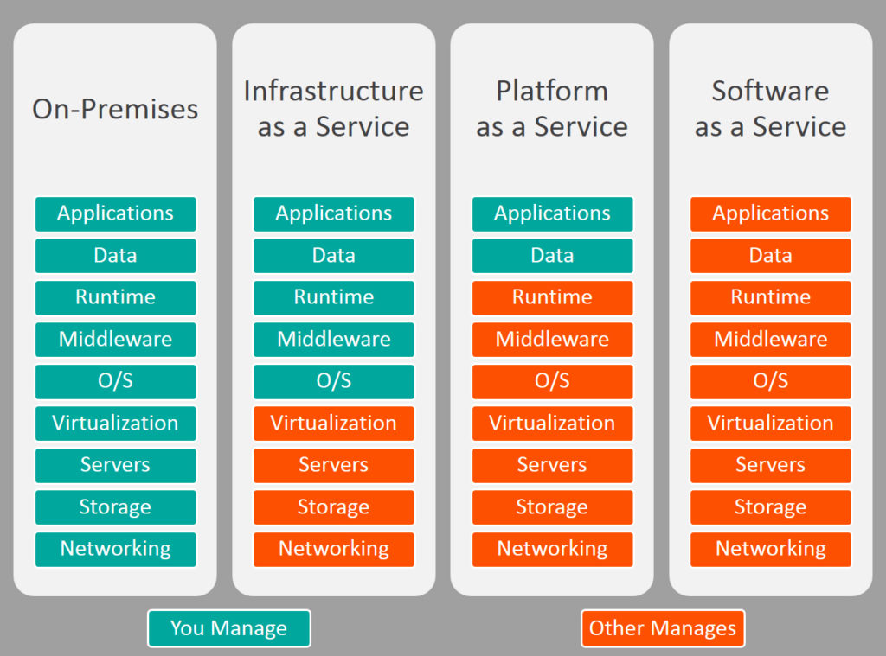


What is Software-as-a-Service (SaaS)?

Slide 4
What is Multi-Tenancy?
A common approach to build SaaS solutions
Hardware & software resources are shared among tenants
Users and application data are isolated between tenants
Concepts:
Tenant: An organization that uses the application or service (and pays for it)
Host: The organization that is responsible to provide the service and manage all the tenants
An ideal multi-tenant application codebase;
Should be unaware of multi-tenancy as much as possible!
Should be deployable as on-premise too

Slide 5
Multi-Tenancy: Advantages
Maximum utilization / low costs
Easy to add a new customer (tenant)
All customers use the same application version
Easier maintanance and upgrade

Slide 6
Multi-Tenancy: Challenges
Data isolation
Configuration & customization per tenant
Data/database backup & restore (per tenant)
Performance: One tenant’s heavy usage may affect the other tenants!

Slide 7
Application State
Application code / services should be stateless!
Main state origins:
Http Request: cookie, header, query string, payload
Authentication ticket/cookie
Database (relational, non-relational, ...)
Distributed cache (redis, memcached, ...)

Slide 8
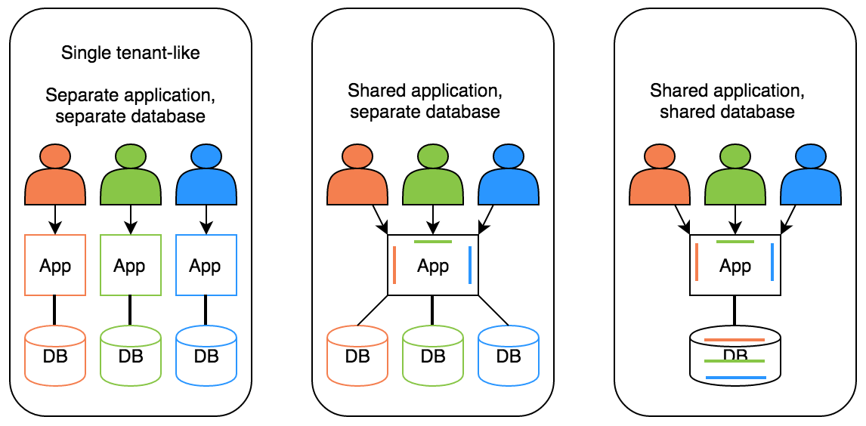
Deployment / Database Architectures
Hybrid!

Slide 9



What is the ABP Framework?
ABP Framework offers an opinionated architecture to build enterprise software solutions with best practices on top of the .NET and the ASP.NET Core platforms.
Your Application
Focus on your own business code!
ABP.IO Platform
Architecture & Infrastructure for Real-World Business Applications
.NET Platform / ASP.NET Core
Web Application & HTTP Service Development Framework

Slide 10
ABP Framework: The Architecture
Domain Driven Design
& Layered Solution
Modular
Multi-Tenancy (SaaS infrastructure)
Microservice ready

Slide 11
ABP Framework: Components
Framework (NuGet & NPM) packages
Application modules
UI themes
Startup templates
ABP CLI

Slide 12
ABP Framework & Multi-Tenancy in Action
DEMO

Slide 13
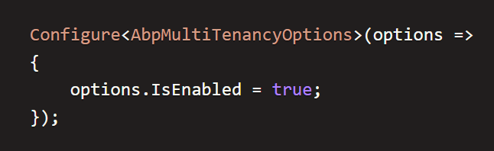
Globally Enable / Disable Multi-Tenancy

Slide 14
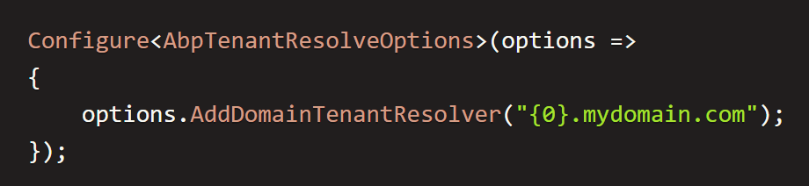
Determining the Current Tenant
Tenant Resolvers
CurrentUserTenantResolveContributor
QueryStringTenantResolveContributor
RouteTenantResolveContributor
HeaderTenantResolveContributor
CookieTenantResolveContributor
And Custom Resolvers (implement ITenantResolveContributor)

Slide 15
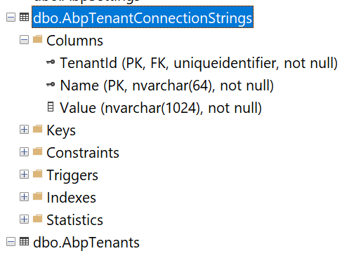
Connection String Selection
Dynamically selects connection string based on
The current tenant
The current module
Fallbacks to the default connection string

Slide 16
ICurrentTenant getting the current tenant
Id (Guid): Id of the current tenant. Can be null.
Name (string): Name of the current tenant. Can be null.

Slide 17
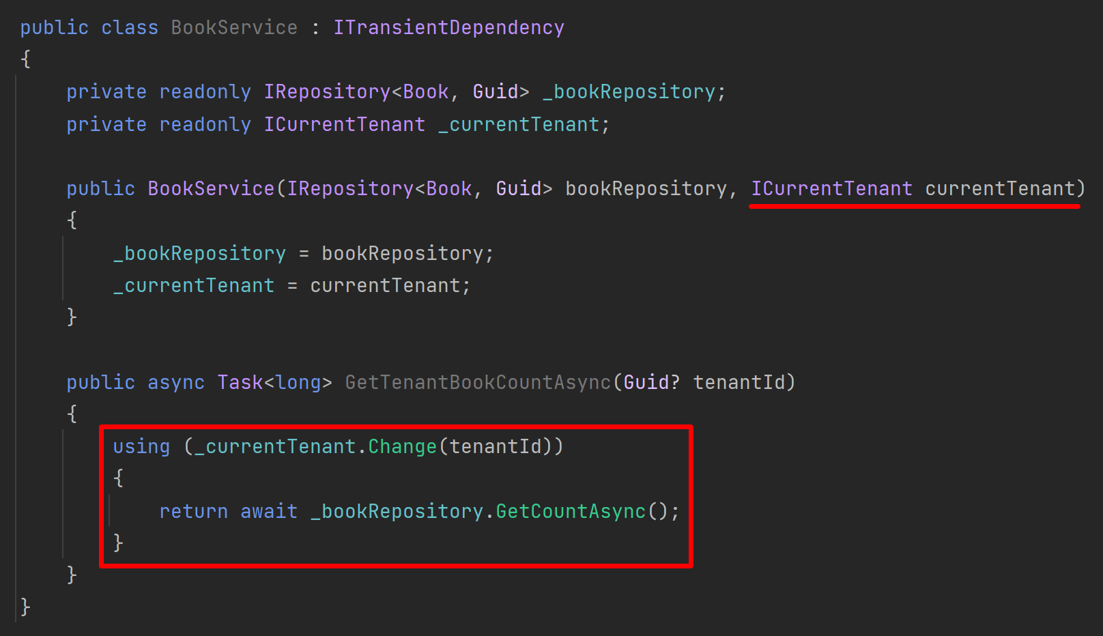
ICurrentTenant switch the current tenant

Slide 18
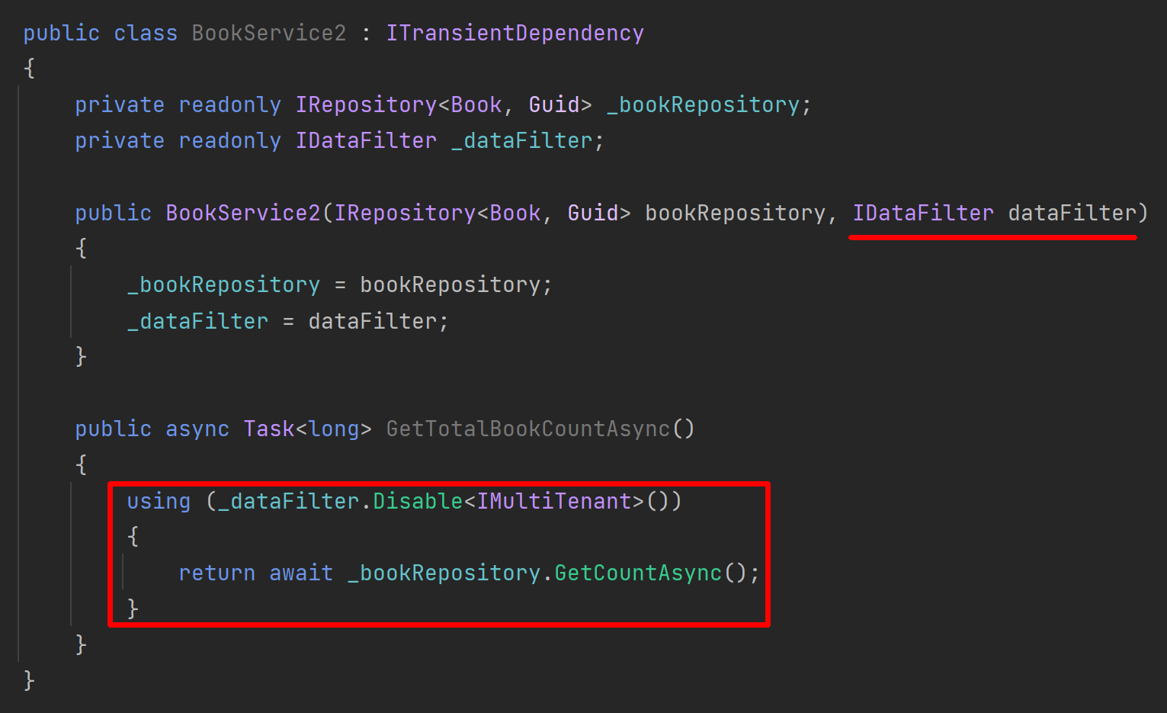
Disabling Multi-Tenancy Filter

Slide 19
The Feature System
Enable, disable or change the behavior of the application features on runtime based on the current tenant.
How to use?
Define your features by code
Use [RequiresFeature] attribute or IFeatureChecker service to control access
Use the Management UI to enable features for tenants

Slide 20
The Feature System
DEMO

Slide 21
ABP: Multi-Tenant Aware Framework
Authentication & Authorization
Audit Logging
BLOB Storing
Caching
Data Seeding
Setting Management
Text Templating
…more

Slide 22

Questions...?
Contact Me:
https://github.com/hikalkan
https://twitter.com/hibrahimkalkan
https://halilibrahimkalkan.com
Get the Presentation: https://github.com/hikalkan/presentations

Slide 23
Topic title
Content

Slide 24
Topic title
Content

